Slide 1
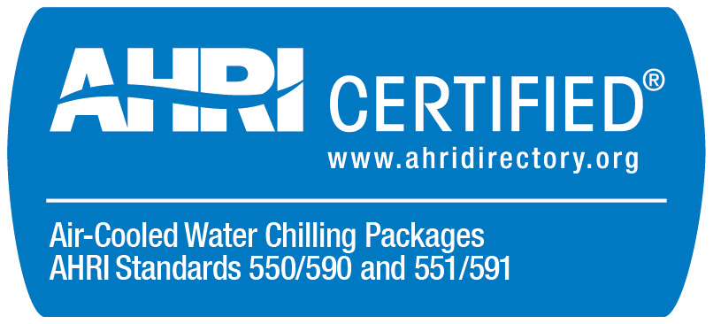

Air-Cooled Chillers (ACCL) and
Water-Cooled Chillers (WCCL) Certification Program Update
2016 and 2017

Slide 2
Updated Sections of the ACCL and WCCL OMs (2016)
Effective April 1, 2016
  1.2: Custom Unit definition change
  1.2 and 3.8: Defined New Product Introduction
  1.2: Defined Catalog / Selection Rating Application
  1.2: Defined Published Ratings
  3.5: Product availability
  3.11: Re-rate requirements added

Slide 3
Updated Sections of the ACCL and WCCL OMs (2017)
Effective January 1, 2017
  1.2.3: New Production Introduction
  1.2.4 and 3.8.8: Modular Chillers
  3.4.5.3: Use of Laboratory Instrumentation
  3.5: Selection of Test Samples
  3.8.6.3: Non-Current Catalog or Selection Rating Application Version
  3.11.1 and 3.11.3: 5th Point Re-Rate Procedure
  4: Challenge Test Procedure
  5.1: Publication of Certified Ratings in Directory

Slide 4
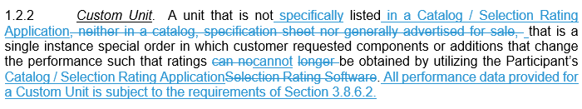
Section 1.2: Custom Unit Definition (2016)
Why: Updated with non-ambiguous requirements.
Removed “generally advertised for sale” and added reference to the Participant’s Catalog / Selection Rating Application.
Notes:
One Participant has re-rated the same BMG for two consecutive years.

Slide 5
Section 1.2: New Production Introduction (2016 and 2017)
Why: Give transparency to the list of New Product Introduction Units.
2016: Added definition including submittal requirements.
2017: Added a public list of New Product Introduction Units to the ACCL and WCCL websites.
  ACCL New Product Introduction Units:
    http://www.ahrinet.org/App_Content/ahri/files/Certification/ResourcesForms/ACCL_New_Product_Introduction_Listings.pdf
  WCCL New Product Introduction Units:
    http://www.ahrinet.org/App_Content/ahri/files/Certification/ResourcesForms/WCCL_New_Product_Introduction_Listings.pdf
Notes:
One Participant has re-rated the same BMG for two consecutive years.

Slide 6
Section 1.2 and 3.8.8: Modular Chillers (2017)
Why: Clarity for certification requirements
Section 1.2.4:
  Modular Chiller Array. A combination of individual certified chillers that may or may not include, from the factory, all required piping, wiring and controls to make the modular chiller array complete. The Modular Chiller Array is not certified, per Section 3.8.8, similar to when other certified chillers are piped and controlled together in the field.
Section 3.8.8:
  Updated to reference Modular Chiller Arrays.

Slide 7
Section 1.2: Catalog / Selection Rating Application (2016)
Why: Clarity for certification requirements
A catalog or selection rating application that allows for selection of any certified product at any published application rating condition per the latest effective edition of the Standard, and shall be in one of the following forms:
  Catalog. Any published material capable of displaying previously generated (i.e. static) performance data.
  Selection Rating Application. Any application capable of generating (i.e. calculating) performance data.

Slide 8
Section 1.2: Published Ratings (2016)
Why: Clarity for certification requirements (distinguish between primary and secondary ratings)
All published ratings of certified products which fall within the scope of the Program shall match the ratings generated using the Participant’s Primary Catalog / Selection Rating Application listed in the AHRI Directory at the time of publication.
  Primary Published Ratings. Ratings published using the Participant’s Primary Catalog / Selection Rating Application listed in the AHRI Directory at the time of publication.
  Secondary Published Ratings. Ratings published using media other than the Participant’s Primary Catalog / Selection Rating Application listed in the AHRI Directory at the time of publication. All Secondary Published Ratings shall be generated using the Participant’s Primary Catalog / Selection Rating Application listed in the AHRI Directory at the time of publication.

Slide 9
Section 3.4.5.3: Use of Laboratory Instrumentation (2017)
Revised to match updates to AHRI Standards 550/590 and 551/591.
  Refer to the Presentation on the updates from 2011 version with Addendum 3 to 2015 version for Standard update information.
Added direction for pairs of instruments.
  If the instrument is part of a pair to calculate a difference (e.g. temperature or pressure) or part of an instrument set to calculate an average (e.g. ambient air temperature or power) then the Laboratory instrumentation data shall be used for both instruments in the pair or all instruments in the instrument set.
(ACCL only) Added barometric pressure measurement comparison.
Notes:
One Participant has re-rated the same BMG for two consecutive years.

Slide 10
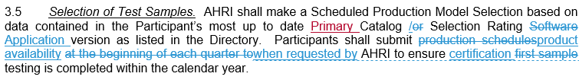
Section 3.5: Product Availability (2016)
Why: To match the current process.
Revised to require Participants to submit product availability when requested.
Notes:
One Participant has re-rated the same BMG for two consecutive years.

Slide 11
Section 3.5: Selection of Test Samples (2017)
Why: To ensure that all BMGs are tested.
Revised to require that a BMG which is not available for selection for three (3) consecutive years be removed from the Directory and classified as Custom Units.
  Custom Units shall not be certified and shall not be listed in the AHRI Directory of Certified Product Performance (Directory). All performance data provided for a Custom Unit is subject to the requirements of Section 3.8.6.2.
Notes:
One Participant has re-rated the same BMG for two consecutive years.

Slide 12
Section 3.8.6.3: Non-Current Catalog or Selection Rating Application Version (2017)
Why: Needed to address customer request for non-current or historical chiller data.
Added to address obsolete and retrofit models.
  “Non-Current Selection which is not certified in accordance with AHRI Water-Cooled Water-Chilling and Heat Pump Water-Heating Packages Certification Program, but is rated in accordance with AHRI Standard 550/590 (I-P) and AHRI Standard 551/591 (SI).”
Notes:
One Participant has re-rated the same BMG for two consecutive years.

Slide 13
Sections 3.11.1 and 3.11.3: 5th Point Re-Rate (2017)
Why: Revised to clarify the requirements of the 5th Point Re-Rate Procedure.
  3.11.1 “For all 5th Point test failures refer to Section 3.11.3. The Participant may elect not to conduct any additional testing because the entire operating map will be re-rated if the re-rate option is chosen.”
  3.11.3 “The Participant is responsible for all additional fees associated with this procedure.”
Notes:
One Participant has re-rated the same BMG for two consecutive years.

Slide 14
Sections 3.11.4 and 3.11.4.1: Re-Rate Requirements (2016)
Why: Included to provide more transparency to re-rated operating maps and a procedure to confirm compliance with AHRI re-rate requirements.
Re-rate submittals
  A written description of the changes made to performance prediction calculations which explain the magnitude and range of revised performance.
  Performance generated from the Primary Catalog / Selection Rating Application before and after the re-rate which shows the magnitude and range of revised performance for a representative sample of models within the failed sample BMG.
Re-rate confirmation
  Additional test required in a year following a re-rate.
Notes:
One Participant has re-rated the same BMG for two consecutive years.

Slide 15
Section 4: Challenge Test Procedure (2017)
Why: Current procedure was not used.
Revised to only reference Section 10 of the AHRI General OM.
Added information about verification procedure (Section 9 of ACCL and WCCL OMs).
Any Participant can request a unit be tested for annual certification.
Notes:
One Participant has re-rated the same BMG for two consecutive years.

Slide 16
Section 5.1: Publication of Certified Ratings in
Directory (2017)
Revised Compressor Designation to Compressor Model Series Information.
Removed Catalog Name and Catalog Version fields.
Revised Selection Rating Application Name to Primary Catalog or Selection Rating Application Name.
Revised Selection Rating Application Version to Primary Catalog or Selection Rating Application Version.
Manufacturing Location, city field to the private directory.
Moved Nominal Cooling and Heating Capacity Ranges to the public directory.
Added Variable Speed Compressor Control Available (Yes or No) field to the private directory.
Notes:
One Participant has re-rated the same BMG for two consecutive years.

